Slide 1
CS4287/5287: Cloud Computing
Fall 2020
Vanderbilt University
Dept of Electrical Eng & Comp Sc
Instructor: Aniruddha (Andy) Gokhale
a.gokhale@vanderbilt.edu
http://www.dre.vanderbilt.edu/~gokhale
Setting up VirtualBox and
Ubuntu as Guest OS

Slide 2
Installation of virtualbox and Ubuntu 18.04 or 20.04 as a guest os
Ubuntu 20.04 LTS is the latest version. The screenshots here were taken for Ubuntu 17.04 and 18.04 in prior years but most of the process should be same in installing Ubuntu 20.04 as guest OS. I am using both 18.04 and 20.04

Slide 3
Goals/Objectives of this Exercise
Once we install VirtualBox, it will allow us to create a “virtual hardware” on our “real hardware” (e.g., laptop)
All this is made possible due to virtualization technologies
The virtual hardware can be configured according to our needs
Naturally, there is not an infinite choice about this but still a large number of discrete choices are available
Once our virtual hardware is spec-ed out by us, it can be instantiated in software by VirtualBox
This virtual hardware can now run an operating system of our choice, which is known as the guest OS
E.g., you can run Linux as a guest OS on top of say your Windows or MacOS-based native/host OS
You can pretty much run all the software which you typically can run on a real hardware and OS but on these virtual hardware

Slide 4
Downloads and Installation
Please have VirtualBox ready on your platform unless your laptop is natively running Linux
www.virtualbox.org/wiki/Downloads
Install it for your platform
Current version is 6.1.x
Apply the extension pack also
Please download latest “desktop version” of Ubuntu
We will use Ubuntu 20.04 LTS (or 18.04 LTS)
http://www.ubuntu.com/download
Your download will be an ISO image
If your laptop is 64-bit machine, download the 64-bit version else the 32-bit version

Slide 5
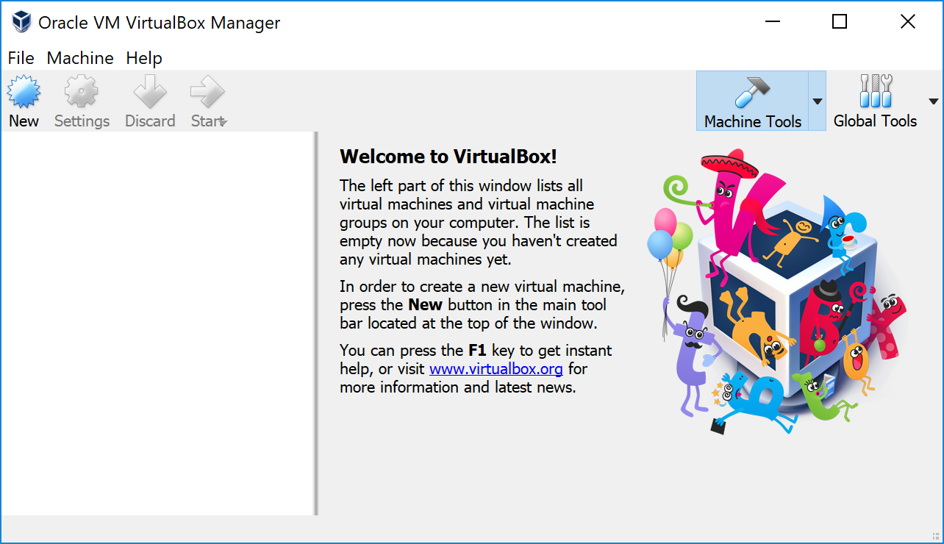
After Starting the Latest Virtualbox

Slide 6
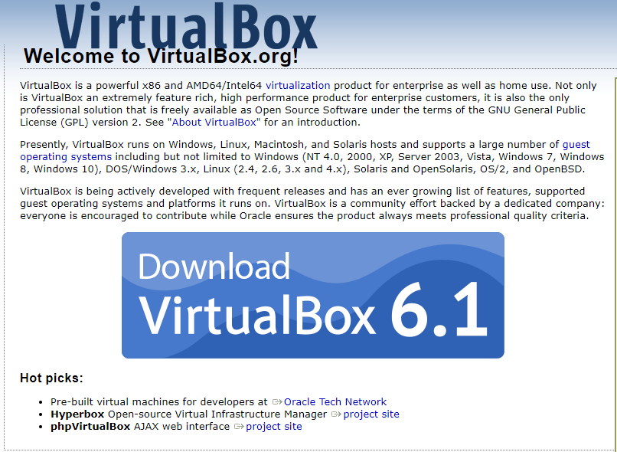
Latest Version of VirtualBox (6.1)

Slide 7
Please note that the slides hereon are from an older version of VirtualBox and an earlier version of Ubuntu that I had installed. But the process should be very similar.

Slide 8
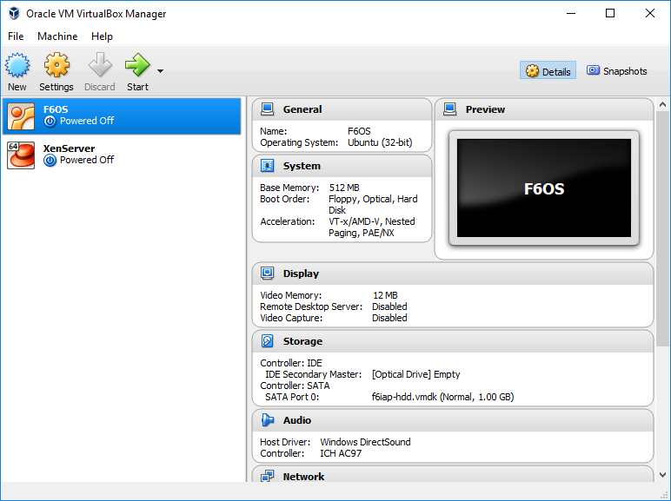
Assembling a Virtual Computer (1/24)
(1) Click New
(2) Your created VM image will show up here like these ones after all the steps are done

Slide 9
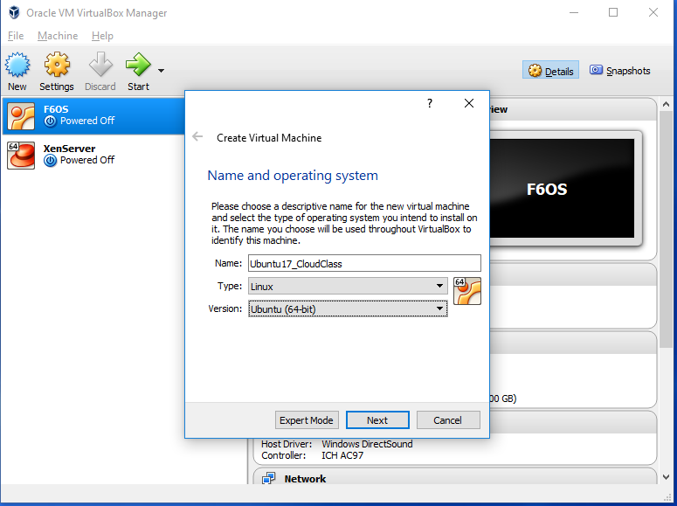
Assembling a Virtual Computer (2/24)
Naming the machine (give some meaningful name) and click next

Slide 10
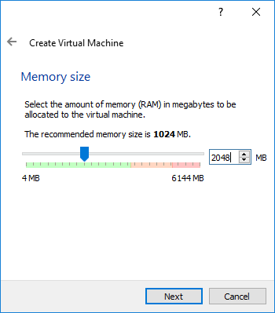
Assembling a Virtual Computer (3/24)
Provide at least 2GB RAM and then click next

Slide 11
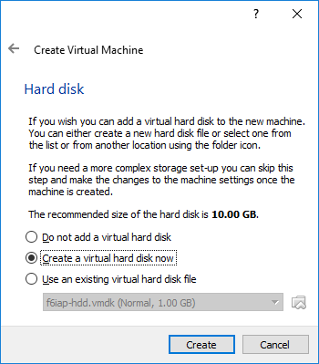
Assembling a Virtual Computer (4/24)
Select “create virtual hard drive” and click create

Slide 12
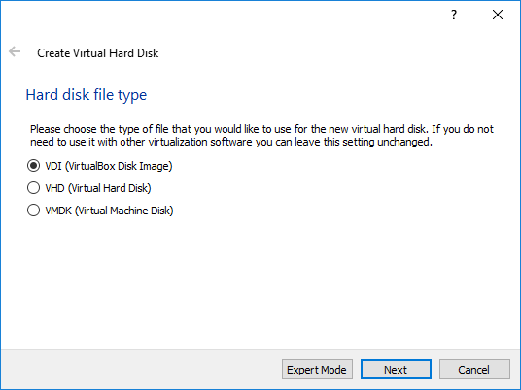
Assembling a Virtual Computer (5/24)
You can use the default, which is VDI and click next

Slide 13
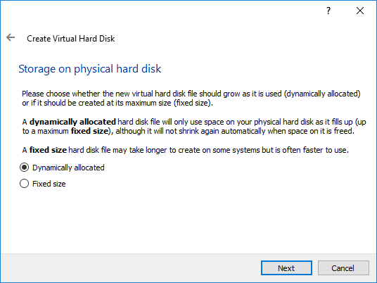
Assembling a Virtual Computer (6/24)
Select “Dynamically Allocated” and click next

Slide 14
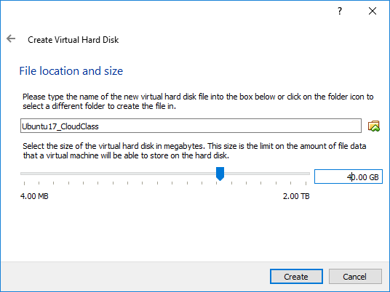
Assembling a Virtual Computer (7/24)
At least 20G virtual hard drive. I have chosen 40 here
Note that because we chose “dynamically allocated”, this virtual disk will not suddenly consume 40G of your real physical hard drive

Slide 15
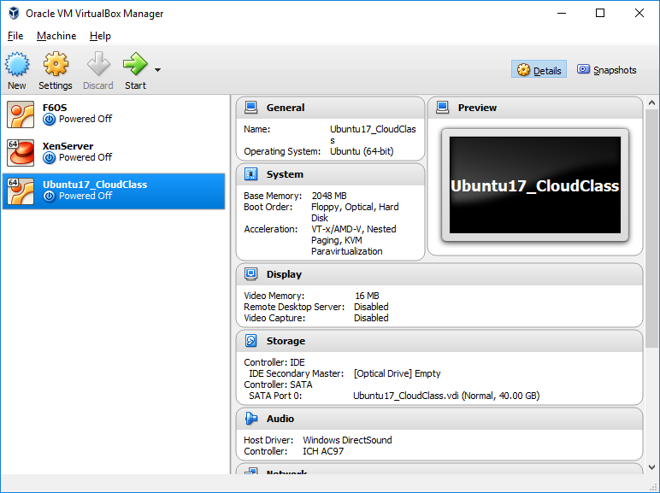
Assembling a Virtual Computer (8/24)
Now, click Settings for your new VM after selecting it
Your newly created virtual hardware

Slide 16
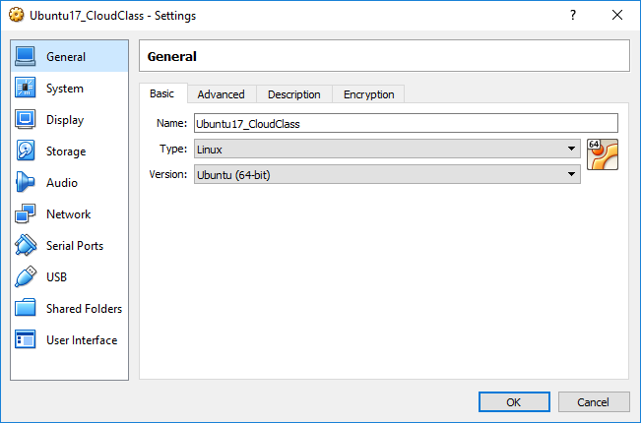
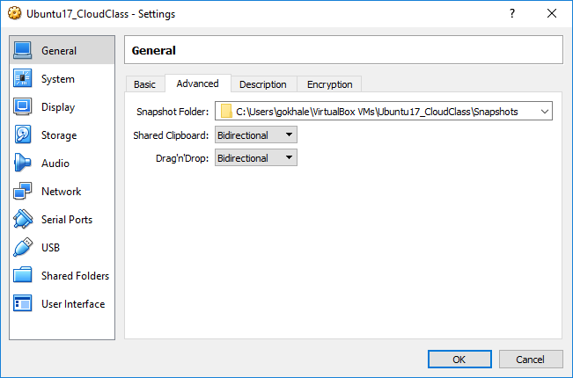
Assembling a Virtual Computer (9/24)
Select the “General” tab
For most of us this will be a 64 bit machine
Under the “Advanced” tab, choose birectional so you can copy-paste in both directions

Slide 17
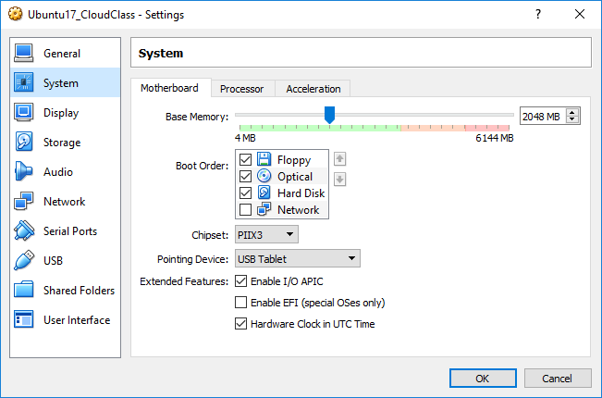
Assembling a Virtual Computer (10/24)
Select the System tab
This should show the same amount of RAM you had initially chosen
Under the Motherboard menu, make these selections and press OK

Slide 18
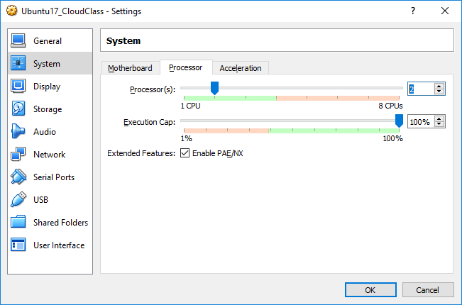
Assembling a Virtual Computer (11/24)
Under the System tab
1 or 2 VCPUs depending on how powerful your real machine is
Under the Processor menu, make these selections and press OK

Slide 19
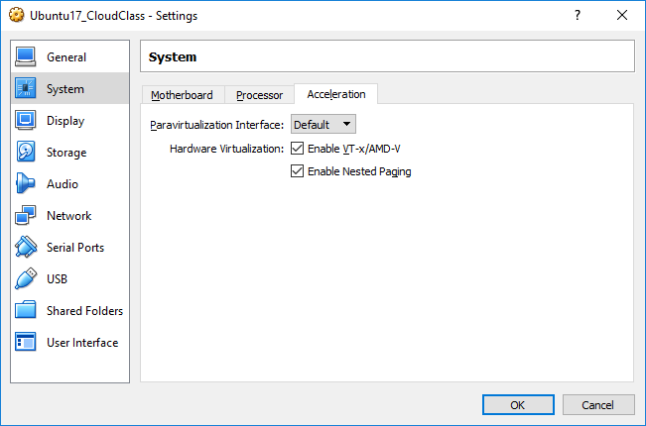
Assembling a Virtual Computer (12/24)
Under the System tab
If you have old “real” hardware, some of these things may not be available. It is OK.
Under the Acceleration menu, make these selections and press OK

Slide 20
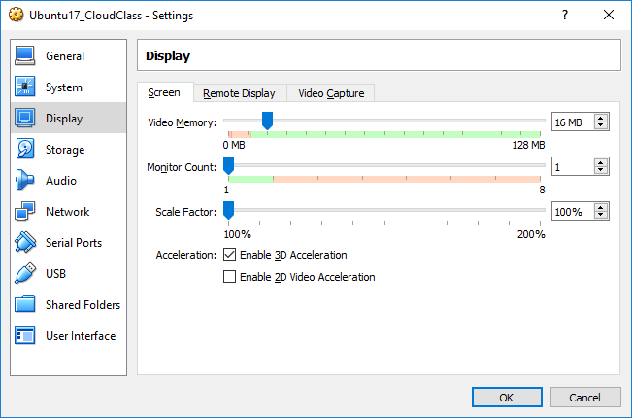
Assembling a Virtual Computer (13/24)
Under the Display tab
Keep the defaults for Screen, Remote Display and Video Capture submenu
Enabling this may give a warning about “Invalid Settings”. Disable it on getting a warning.

Slide 21
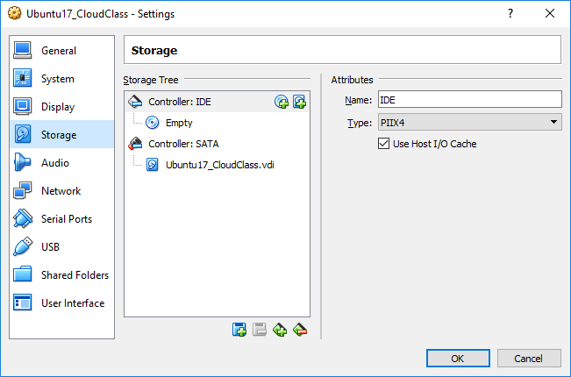
Assembling a Virtual Computer (14/24)
Under the Storage tab
Keep defaults and press OK

Slide 22
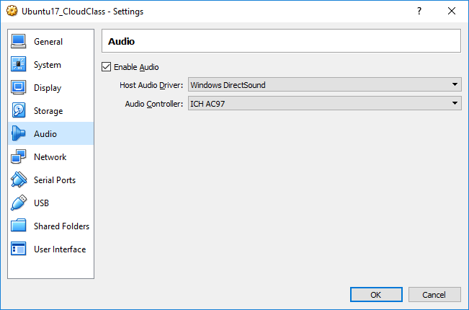
Assembling a Virtual Computer (15/24)
Under the Audio tab
Enable audio so you can play audio in your virtual hardware and can hear on your real speaker. Press OK.

Slide 23
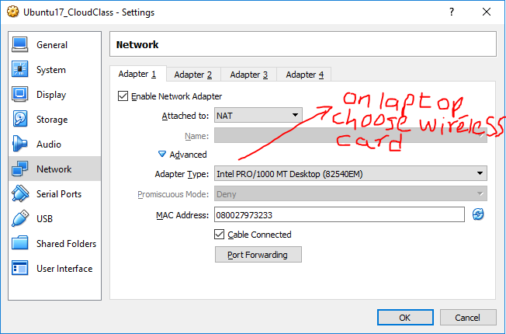
Assembling a Virtual Computer (16/24)
Under the Network tab
Setup a NAT-based connectivity for Adapter number 1
Make these selections under the advanced menu and press OK. Don’t worry about port forwarding

Slide 24
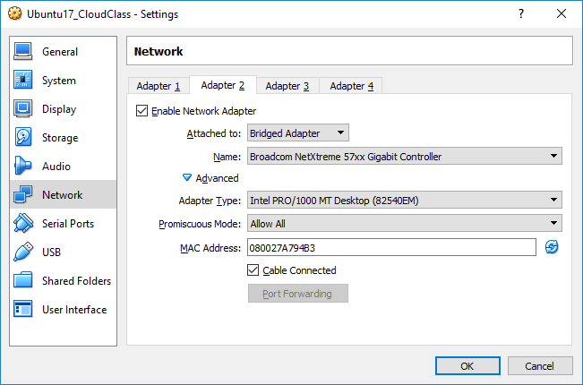
Assembling a Virtual Computer (17/24)
Under the Network tab
You can skip this step for now. We can visit this later on
Setup a Bridge Adapter for Adapter number 2
Make these selections under the advanced menu and press OK.

Slide 25
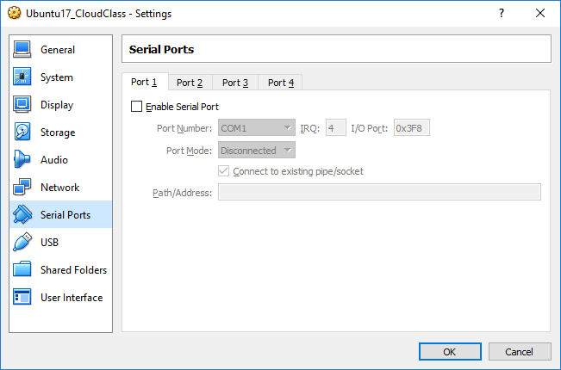
Assembling a Virtual Computer (18/24)
Under the Serial Port tab
Keep defaults. We are not going to use serial port. Press OK.

Slide 26
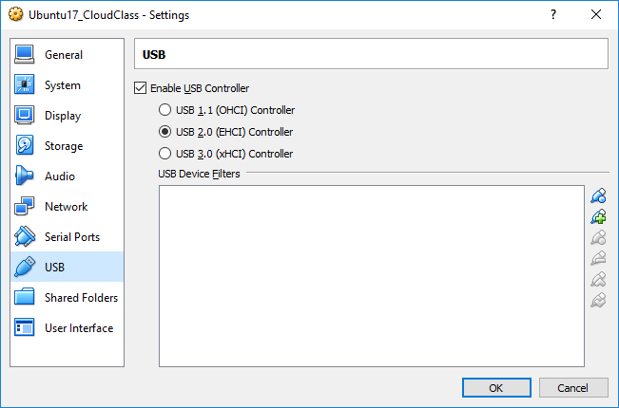
Assembling a Virtual Computer (19/24)
Under the USB tab
Enable USB and select default (USB 2). Press OK.

Slide 27
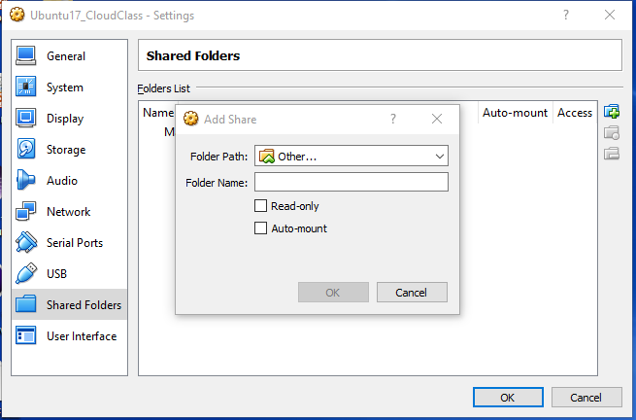
Assembling a Virtual Computer (20/24)
Under the Shared Folder tab
Select Other by expanding the menu
Check Auto-mount; uncheck Read-only since you may want to write back

Slide 28
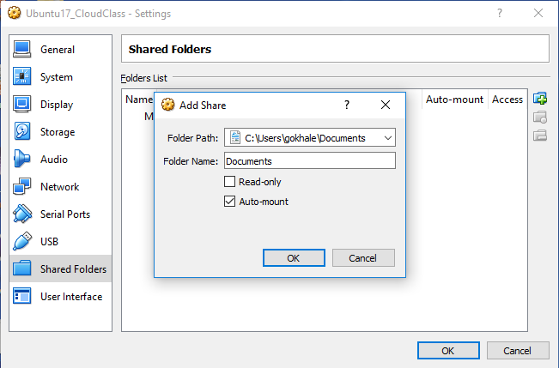
Assembling a Virtual Computer (21/24)
Under the Shared Folder tab
Browse to the path on host machine that you want to have access to for read/write
Give some name to it that it will be referred to from guest OS
Check Auto-mount; Uncheck Read-only since you may want to write back

Slide 29
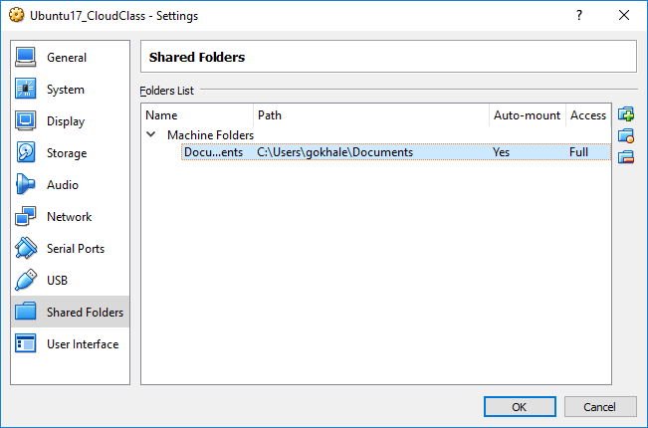
Assembling a Virtual Computer (22/24)
Under the Shared Folder tab
End result should look something like this (Auto-mount is Yes, Access is Full)

Slide 30
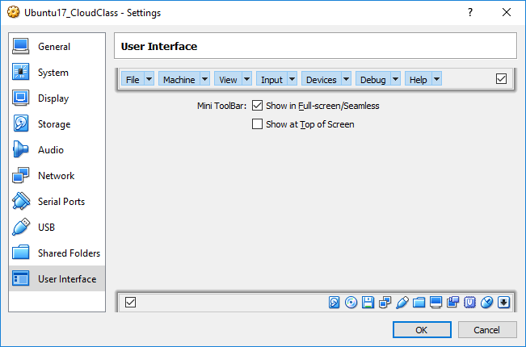
Assembling a Virtual Computer (23/24)
Under the User Interface tab
Select the default as shown and press OK

Slide 31
Assembling a Virtual Computer (24/24)
Next, click this button to power on your new machine
Congratulations !! You have assembled a virtual computer at this time. Now, you are ready to power it on (but it is still a bare bones “virtual hardware” with no software on it as we shall find out).

Slide 32
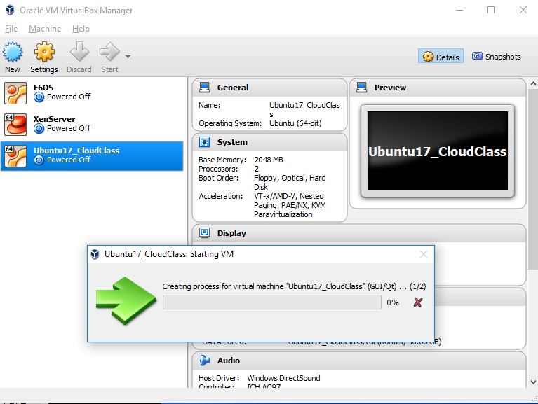
Booting up the Virtual Machine (1/6)
You will see some activity like this

Slide 33
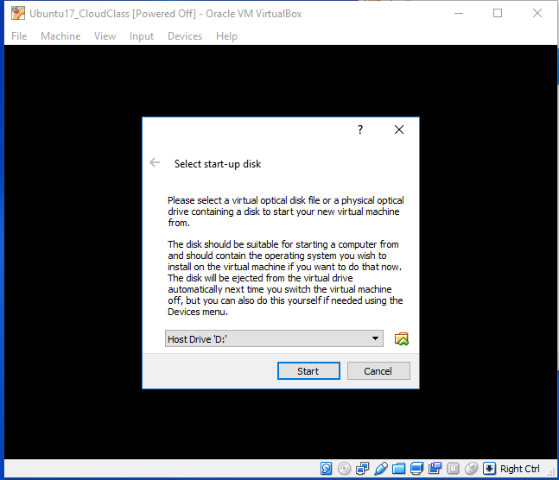
Booting up the Virtual Machine (2/6)
The boot process will ask you from which drive to boot from

Slide 34
Booting up the Virtual Machine (3/6)
Now click this symbol and it will open up the explorer window

Slide 35
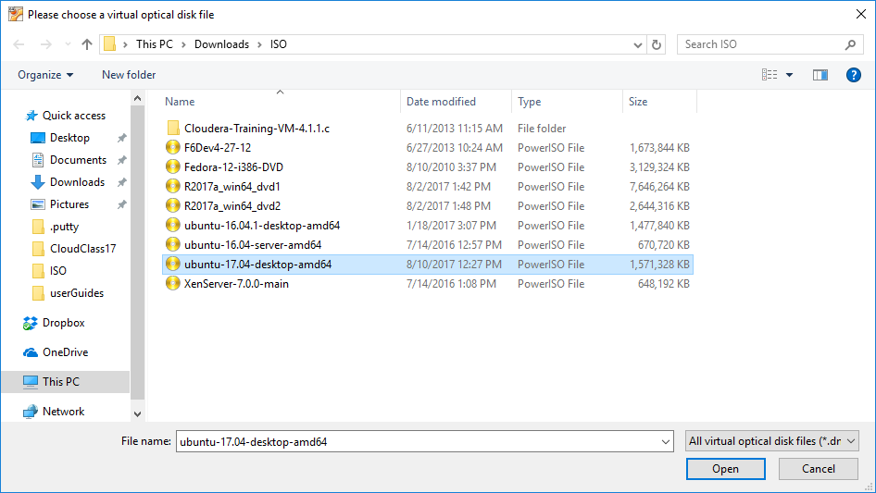
Booting up the Virtual Machine (4/6)
Go to the directory where you saved the downloaded ISO image for Ubuntu 17.04 (in your case 18.04). Select it and click Open.

Slide 36
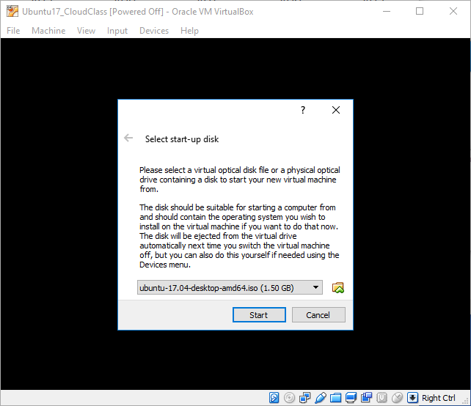
Booting up the Virtual Machine (5/6)
You should now see the ISO image you selected. Press Start.

Slide 37
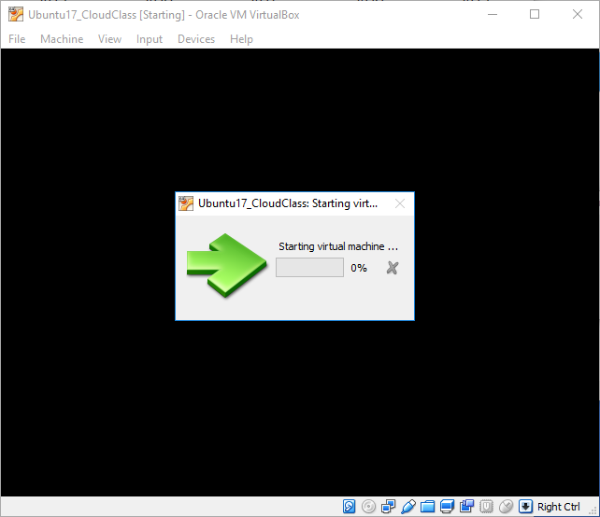
Booting up the Virtual Machine (6/6)
Your VM is now starting. Get ready to install Ubuntu as the Guest Operating System

Slide 38
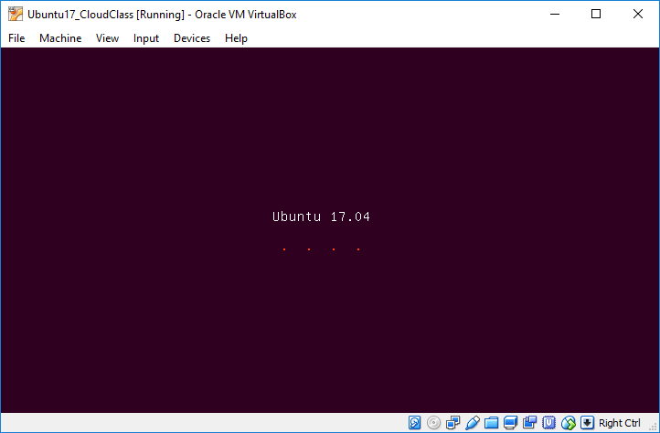
Installing Ubuntu as Guest OS (1/34)
You should now see something like this. Note, Ubuntu is not yet installed.

Slide 39
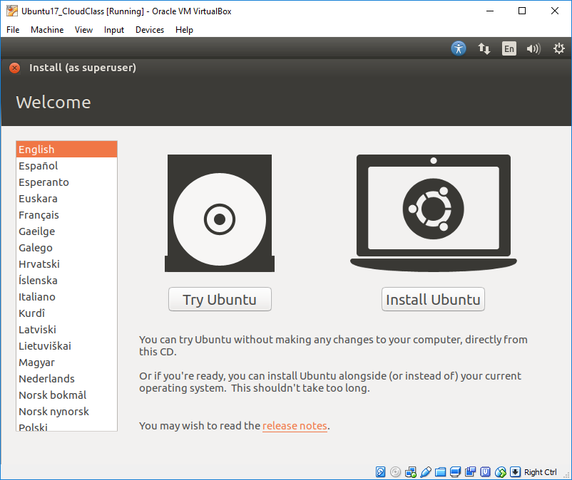
Installing Ubuntu as Guest OS (2/34)
Select “Install Ubuntu”

Slide 40
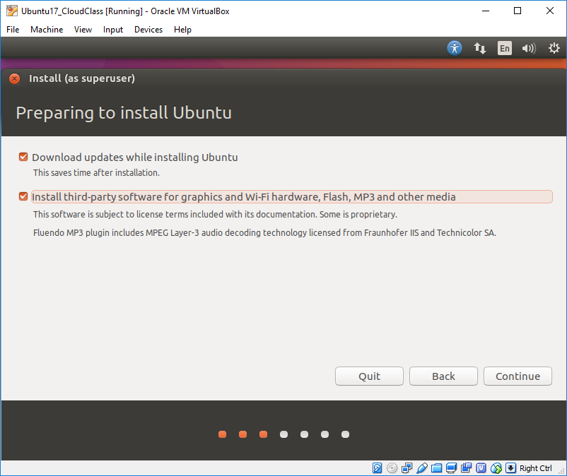
Installing Ubuntu as Guest OS (3/34)
Check these two boxes and press Continue. Make sure you are connected to the network

Slide 41
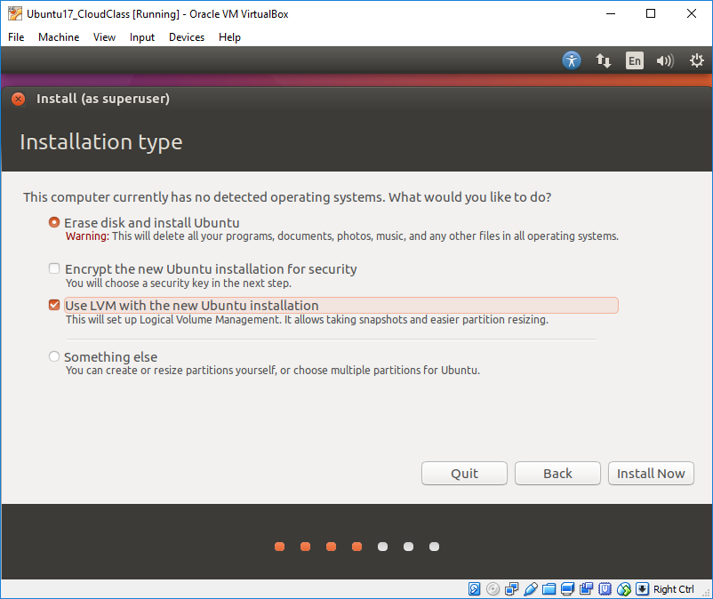
Installing Ubuntu as Guest OS (4/34)
Check the two boxes and press Continue. Don’t worry about erase disk – this is not about erasing your real hard drive.

Slide 42
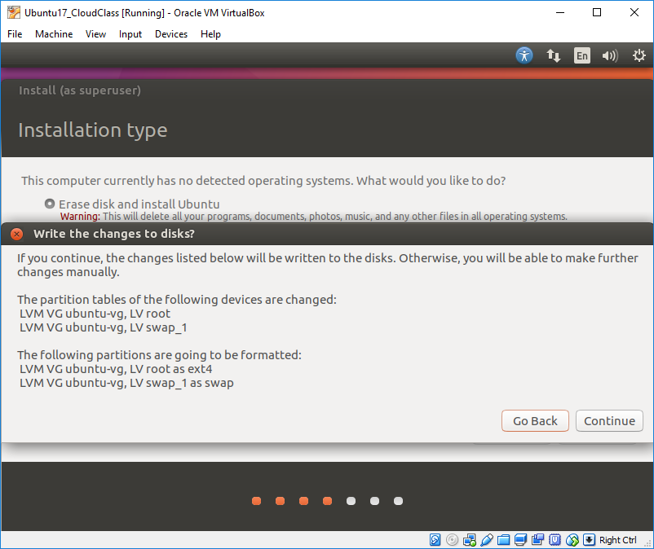
Installing Ubuntu as Guest OS (5/34)
You will see something like this. Press continue.

Slide 43
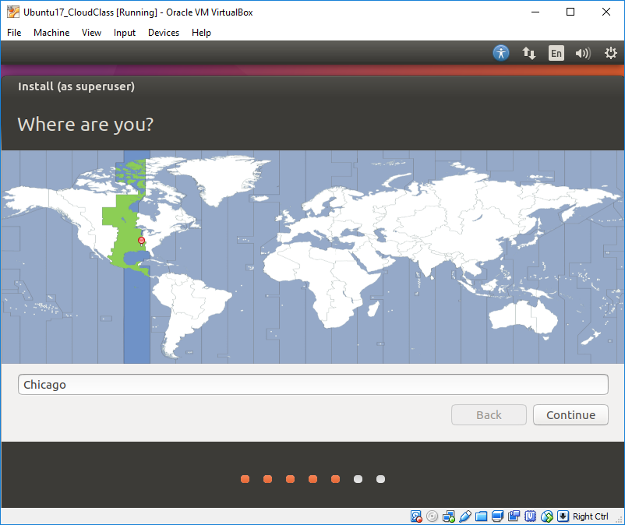
Installing Ubuntu as Guest OS (6/34)
Since we are in central time zone, select Chicago and press Continue.

Slide 44
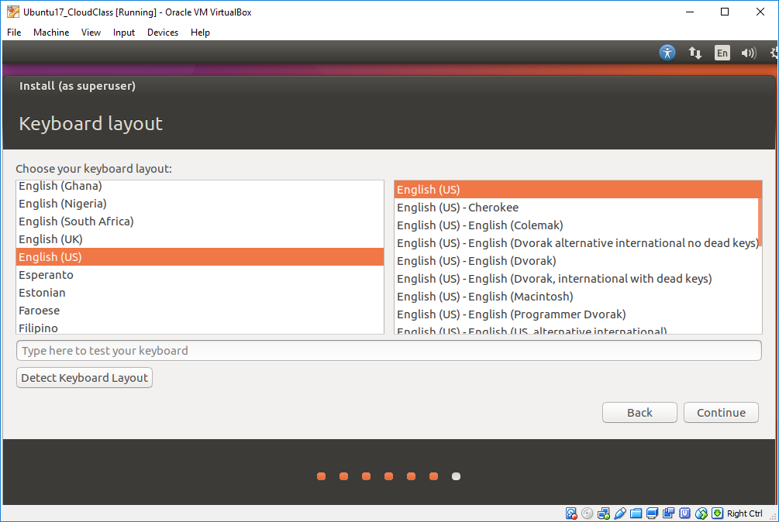
Installing Ubuntu as Guest OS (7/34)
Default keyboard type and layout is English(US). Press continue.

Slide 45
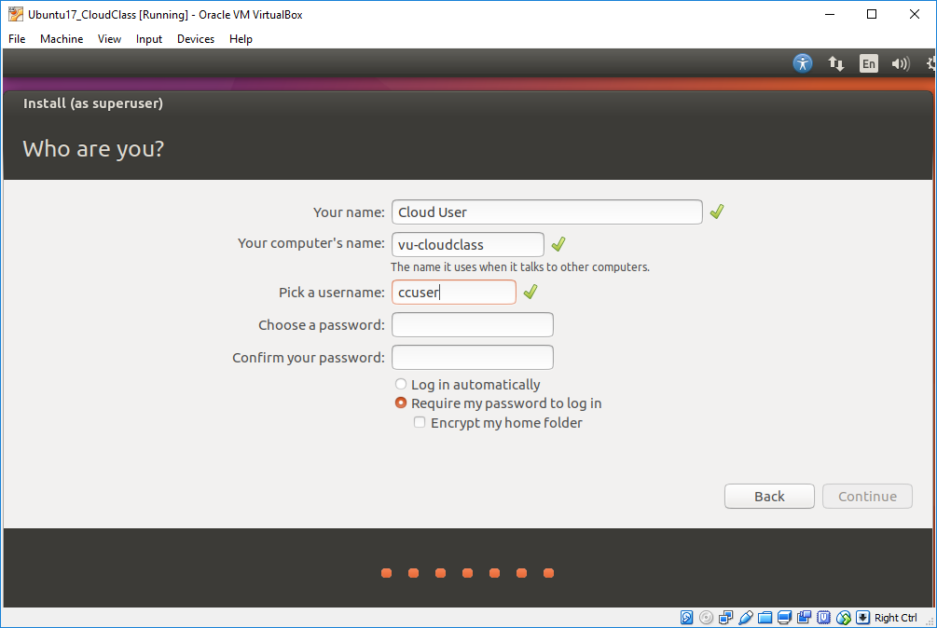
Installing Ubuntu as Guest OS (8/34)
Choose a login name. This user will have super user access on your VM. In later slides you may see my lastname as the username, which is what I set for my VM

Slide 46
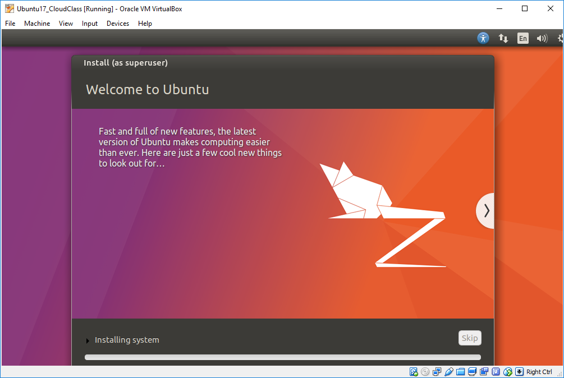
Installing Ubuntu as Guest OS (9/34)
You will see some activity as the installation process continues. Just keep watching until you are prompted.

Slide 47
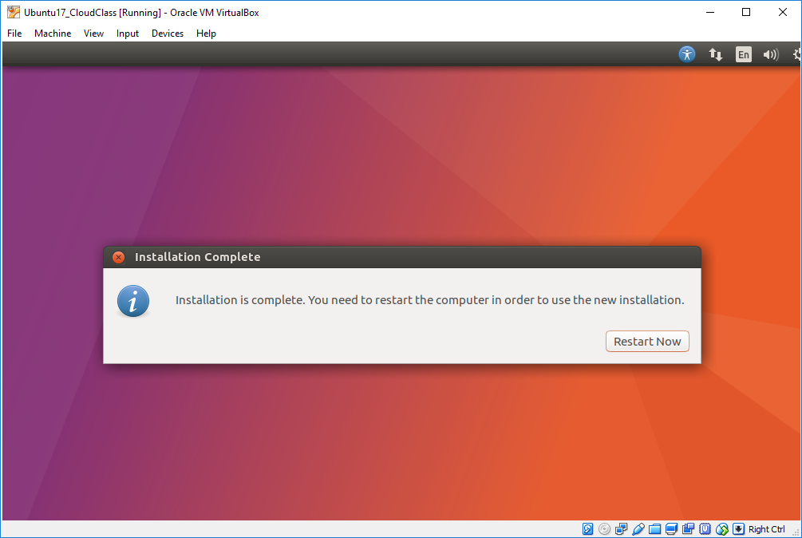
Installing Ubuntu as Guest OS (10/34)
At this stage, click Restart Now

Slide 48
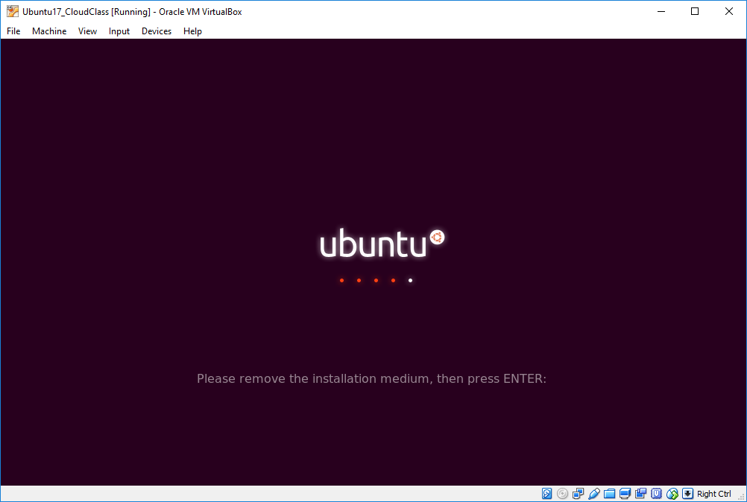
Installing Ubuntu as Guest OS (11/34)
Do not worry about removing any media. Let the system boot up again.

Slide 49
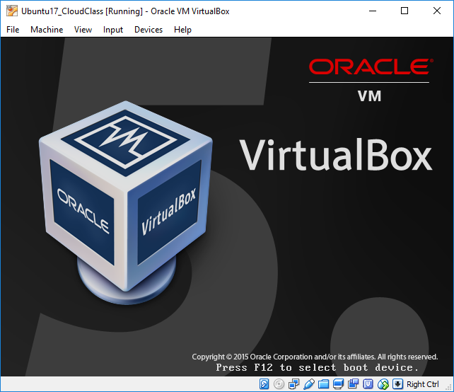
Installing Ubuntu as Guest OS (12/34)
Don’t worry about this. Let it continue booting.

Slide 50
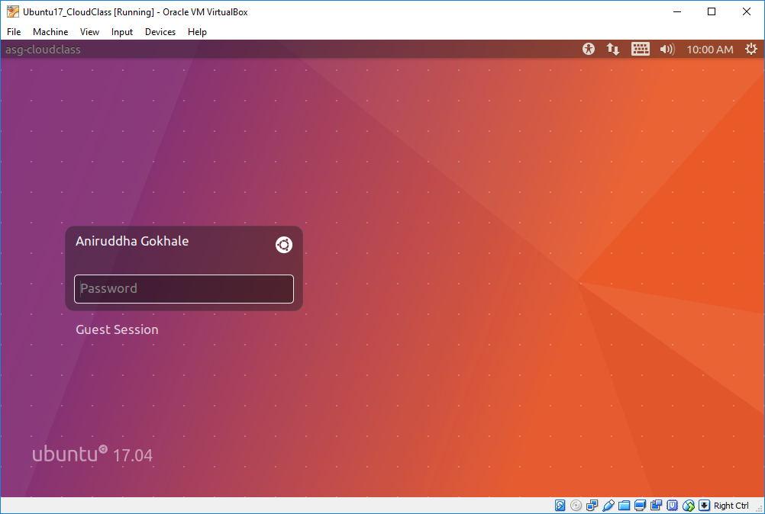
Installing Ubuntu as Guest OS (13/34)
Congratulations !! You have now installed Ubuntu as a guest OS and are able to boot into it at this stage.
You should get this log in prompt for the user you created. Here I created one more me. Enter the password for your user.

Slide 51
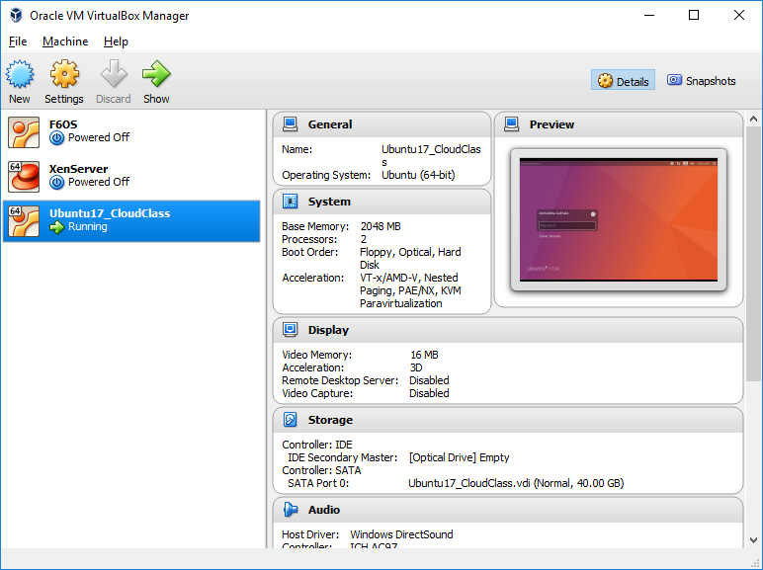
Installing Ubuntu as Guest OS (14/34)
A glance at the VirtualBox manager window shows your VM in the “Running” state

Slide 52
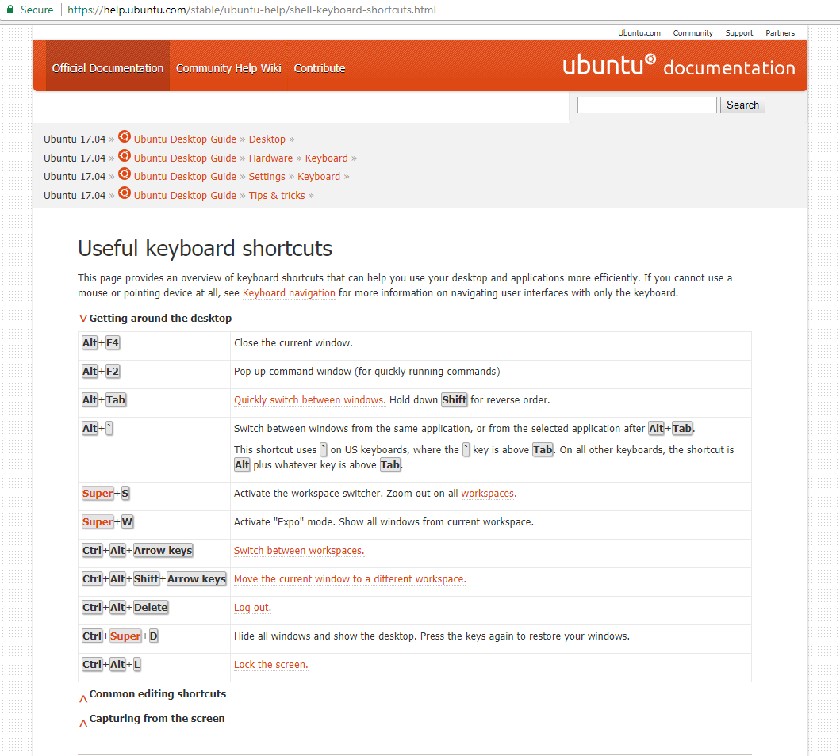
Installing Ubuntu as Guest OS (15/34)
Back in your VM, you might see this initial screen showing keyboard shortcuts

Slide 53
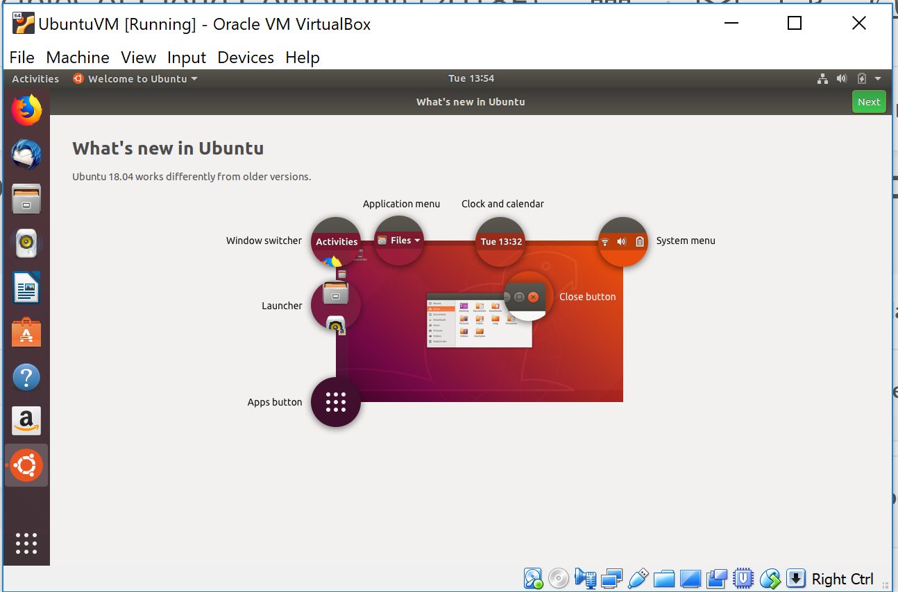

Slide 54
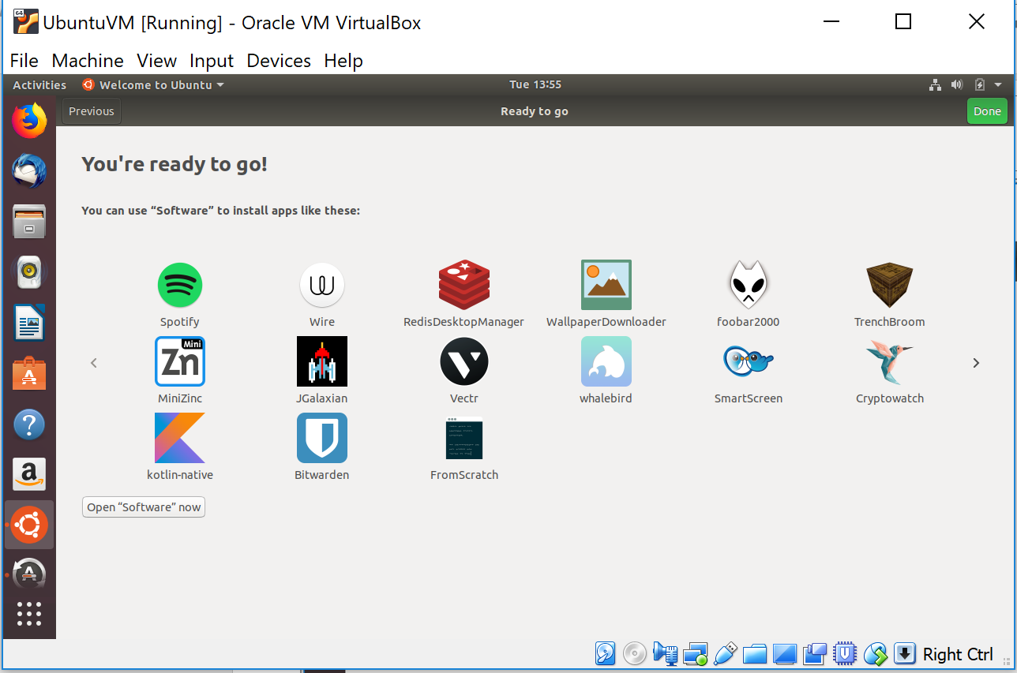

Slide 55
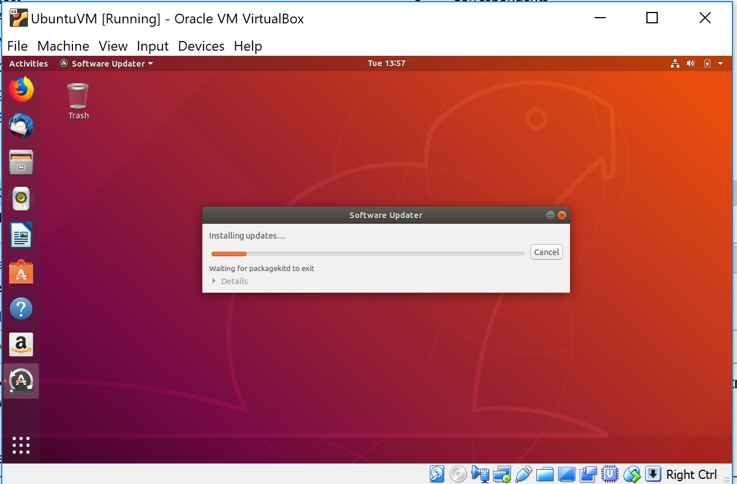

Slide 56
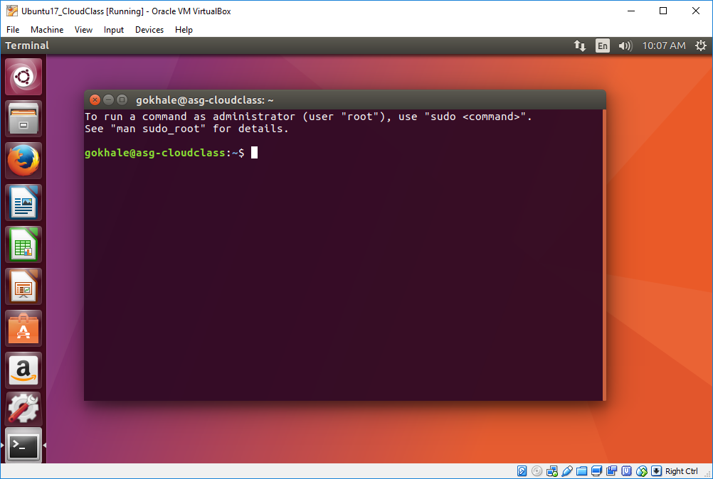
Installing Ubuntu as Guest OS (16/34)
Try CTRL-ALT-t and you should see a bash shell open up

Slide 57

Installing Ubuntu as Guest OS (17/34)
This may pop up. We need to install it for some features like shared folder to work. Click Run.

Slide 58

Select the “Insert Guest Addition” from Devices pull down menu if you don’t get this by default

Slide 59

You may first need to install these packages via sudo apt-get install

Slide 60


Slide 61

Installing Ubuntu as Guest OS (18/34)
It will ask you for your password. Since you are superuser, you can install the additions.

Slide 62

Installing Ubuntu as Guest OS (19/34)
After the Additions are installed, press Return to close the window

Slide 63

Installing Ubuntu as Guest OS (20/34)
Pulldown menu to get the option to shutdown or press CTRL-ALT-DEL
Shutdown/reboot to get the features enabled.

Slide 64

Installing Ubuntu as Guest OS (21/34)
Pulldown menu to get system settings or from left side menu
Here you can set a variety of features of your virtual machine

Slide 65

Installing Ubuntu as Guest OS (22/34)
Pulldown menu to get system settings or from left side menu
For example, here we set how long of inactivity before the screen turns off

Slide 66

Installing Ubuntu as Guest OS (23/34)
Open a shell and type “cd /media/sf_<name you gave for your shared folder>” and then type “ls –l” to see the contents. Most likely, permissions will be denied.
Note that this is your shared folder from your host machine that you are trying to access.

Slide 67

Installing Ubuntu as Guest OS (24/34)
sudo command allows a user to execute commands as superuser as long as that user belongs to the sudoers group
To be able to access the shared folder, type the command as shown (without the double quotes):
“sudo adduser <user loginname> vboxsf”
Effectively, we are going to add ourselves to the vboxsf group.

Slide 68
Installing Ubuntu as Guest OS (25/34)
Reboot the machine as you did before. Simply logging out and logging back in may also work but I found that rebooting certainly worked.

Slide 69

Installing Ubuntu as Guest OS (26/34)
Once you have rebooted and opened a shell, type “cd /media/sf_<name you gave for your shared folder>” and then type “ls –l” to see the contents.

Slide 70

Installing Ubuntu as Guest OS (27/34)
So that we do not need to supply a password every time we use the sudo command, we are going to modify an internal file via the “visudo” command. Do not type this as we will do it a different way as shown in a couple of slides

Slide 71

Installing Ubuntu as Guest OS (28/34)
This is the file we need to modify. But there is a better way shown next

Slide 72

Installing Ubuntu as Guest OS (29/34)
Instead, type this command. The “user_overrides” is a file name I have chosen. You can use a name of your choice.

Slide 73

Installing Ubuntu as Guest OS (30/34)
Add this one single line. Here I have shown my login ID but you should use yours. This will allow your login ID to execute any command under “sudo” to be executed without the need for a password. Save the file (ctrl-o); see commands in the window.

Slide 74

Installing Ubuntu as Guest OS (31/34)
Here I am showing how to install software packages on Ubuntu via sudo. Here I am installing the emacs text editor. Notice, it did not ask me for password. Click Y to install.

Slide 75

Installing Ubuntu as Guest OS (32/34)
Here I am showing how to edit a file. If you find yourself using a command that needs too much typing, you can create an alias (shortcut) for it and save it

Slide 76

Installing Ubuntu as Guest OS (33/34)
This is editing inside emacs. Here I am setting cls=clear so that when I type cls, the shell will clear itself. This will be active after I save this file and activate the aliases.

Slide 77
Installing Ubuntu as Guest OS (34/34)
So much for an initial introduction to VirtualBox and a guest OS installation
We will use this VM (virtual machine) on our laptop as our “client machine”
We will use Ubuntu 18.04 (or 20.04) as our client-side OS and software programs
In subsequent lectures, we will be installing a whole lot of software in our client machine via the “sudo apt-get” command
Many python packages will be installed via the pip command

Slide 78
Some Useful Packages
net-tools (contains ifconfig)
Install using command sudo apt-get install net-tools
Git is needed for checking out software
sudo apt-get install git
Java will be needed for running Spark, Kafka, etc
Latest default Java version is 11 and is supported by latest versions of Spark and Kafka (else earlier only version 8 was supported)
sudo apt-get install default-jdk
sudo apt-get install default-jre (won’t do anything as the above command will install it)
Type java –version to check which version got installed
pip3 is needed to install Python3 packages
sudo apt-get install python3-pip
Note that Python2 has reached end-of-life and is no longer installed by default on Ubuntu 20.04

Slide 79


